Slide 1
Data Exploration of Building Metadata
Kunal Sharma; feb 6, 2019
Georgia tech; Areospace design Lab

Slide 2
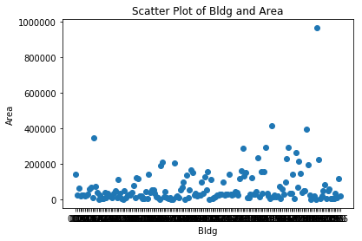
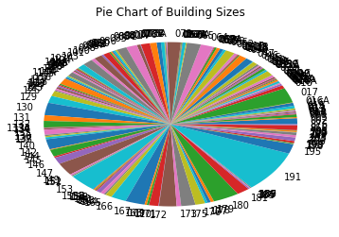
Building Area

Slide 3
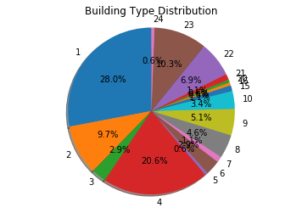
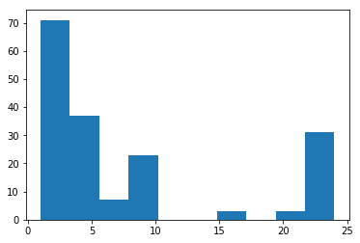
Primary Use Distribution

Slide 4
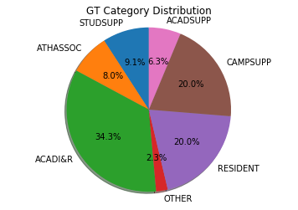
GT Category Distribution

Slide 5
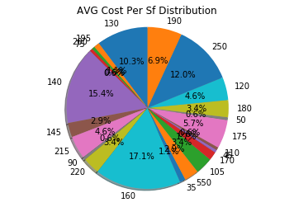
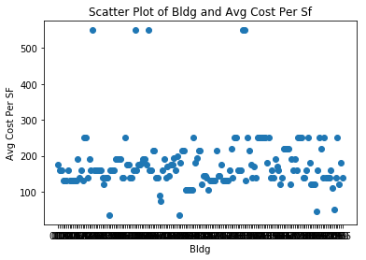
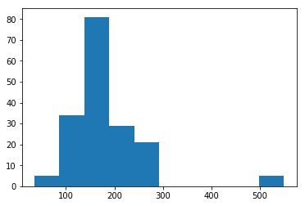
Avg Cost Per Sf

Slide 6
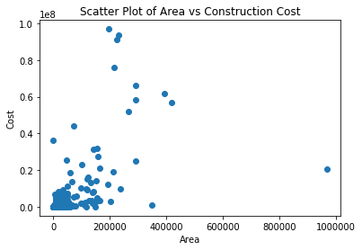
Area vs Construction Cost

Slide 7
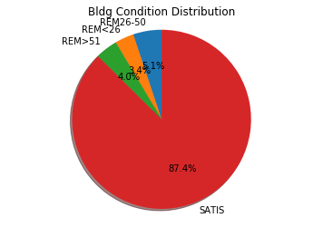
Bldg Condition Distribution

Slide 8
Possible Approach
Step 1: Find the Correlations Between Metadata Features and Yearly/Monthly Consumption
Assumption: Strong positive correlation → “Buildings with similar data

Slide 9
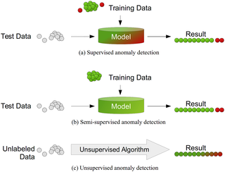
Problem Statement Redefined
Detecting and ranking buildings behaving most abnormally using unsupervised anomaly detection algorithms for Multivariate Data.
(Similar application to credit card fraud detection.)

Slide 10
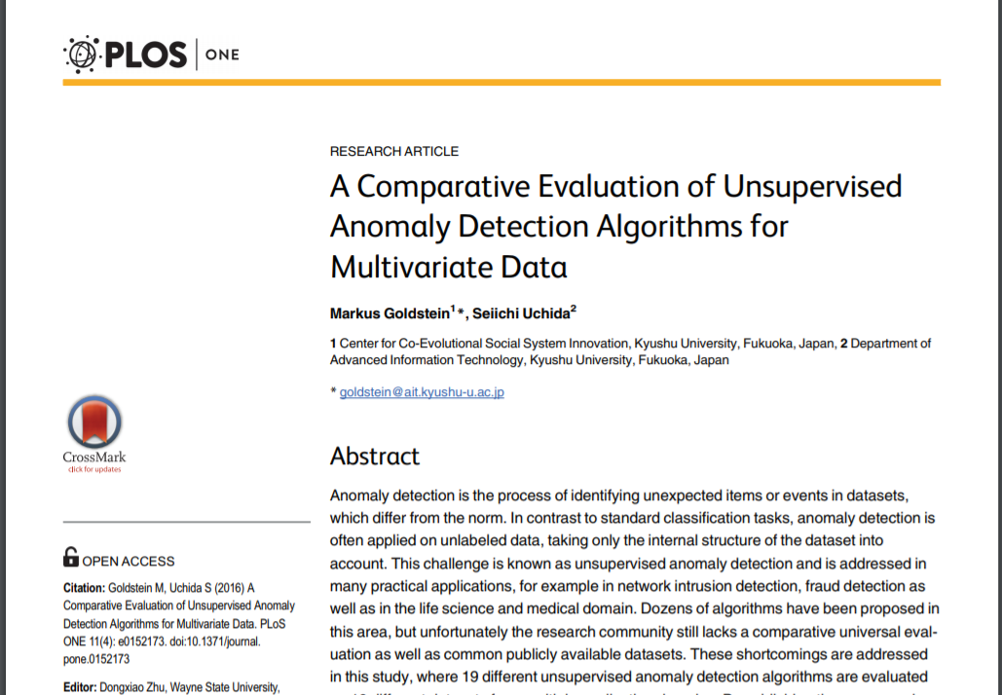
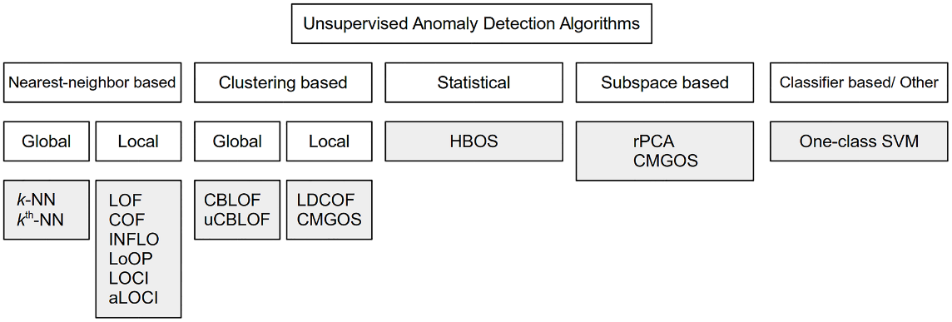
Possible Methods

